Slide 1
High Performance Big Data Analytics
Project Members: Kshitij Jaiswal, Anirudh Srikanth Supervisor: Professor Dip Sankar Banerjee

Slide 2

Overview
BFS (Breadth First Search) is a fundamental graph search algorithm exploring uniformly in all directions. Its utility extends to Machine Learning algorithms, notably for finding minimum distances from a source to all other vertices (Single Pair Shortest Path). Parallelizing BFS can significantly enhance the algorithm's overall performance by optimizing traversal through graphs.

Slide 3
Characteristics of Big Graphs
Big graphs (e.g., AWS, Meta) exhibit small world and scale-free characteristics.
Small world: High local clustering with short average path lengths.
Scale-free: Power-law degree distribution, hubs with more connections.
Adaptation of BFS algorithms for these graphs.

Slide 4
Top-Down BFS
Top-Down BFS methodically explores the neighbors of each node in the current frontier. If an unvisited neighbor is found, it's added to the next frontier. However, in scenarios where the current frontier engulfs a large portion of the graph, this approach might extensively traverse all edges, resulting in a time complexity of O(n^2) for graphs with m ~ n^2.

Slide 5
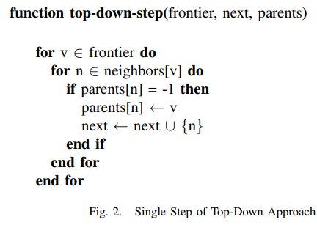
Algorithm

Slide 6
Bottom-Up BFS
Bottom-Up BFS proves efficient when the frontier size is substantial. Here, the algorithm traverses through all nodes in the graph and checks whether a node's successor is present in the current frontier. This optimization is shows effect in the parallel setting, but for iterative BFS the time complexity remains O(nm).

Slide 7
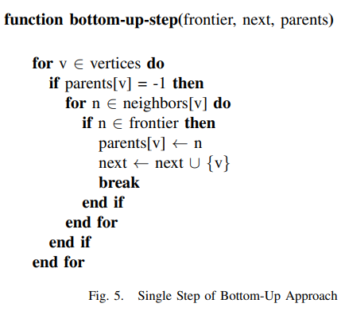
Algorithm

Slide 8
Hybrid BFS
The Hybrid BFS strategy amalgamates both top-down and bottom-up BFS methodologies, dynamically shifting between them based on specific conditions. These conditions, rooted in metrics such as m_{f}, n_{f}, C_{BT}, and C_{TB}, facilitate an adaptive frontier size, resulting in more efficient BFS traversal.

Slide 9
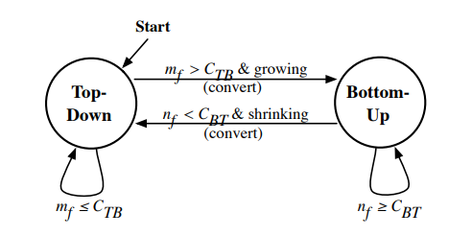
Algorithm

Slide 10
Understanding k-regular Graphs
A k-regular graph: Each vertex has k neighbors.
Upper bound on diameter: n/k.

Slide 11
Time Complexity
 | Sequential | Parallel
Top Down | O(n+m) | O(n)
Bottom Up | O(n*m) | O(n)

Slide 12
Our Implementations

Slide 13
OpenMP
OpenMP, an API designed for shared-memory systems, revolutionizes parallel programming. By integrating OpenMP into BFS algorithms, we harness the power of multi-threading, enhancing the performance of traditional sequential BFS.
We first implemented it using OpenMP to get clarity on the possible contentions and realise the possible speedup..

Slide 14
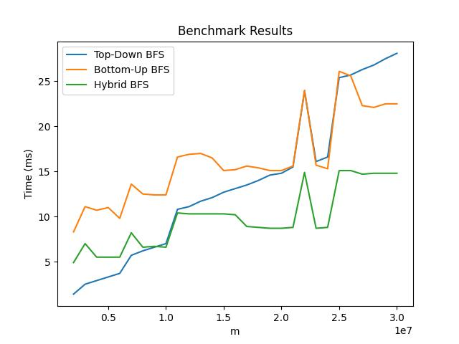
Edges vs Time

Slide 15
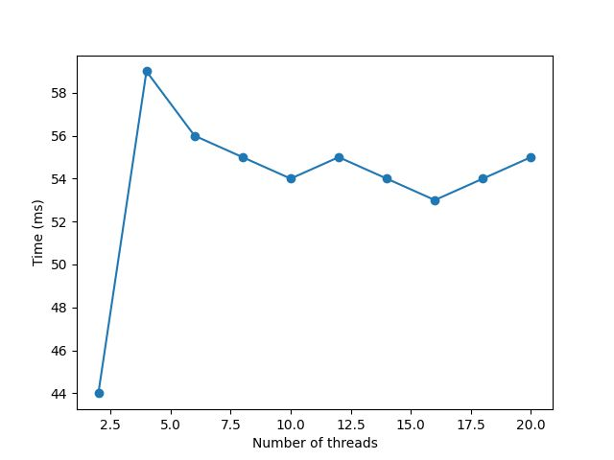
# of Threads vs Time

Slide 16
CUDA
CUDA: Parallel computing platform for GPUs.
Advantages over OpenMP in BFS traversal times since rather than limiting ourselves to just 20 threads, we now could use upto 2⁴¹ ~ 2.2 X 10¹² threads since we had 2³¹ blocks, each block had 2¹⁰ threads.
CUDA was 15.43 times faster than OpenMP and 57.62 times faster than sequential BFS.

Slide 17
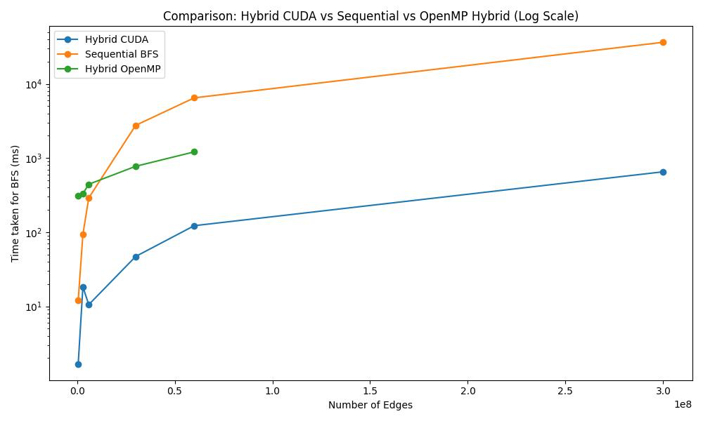
CUDA Performance

Slide 18
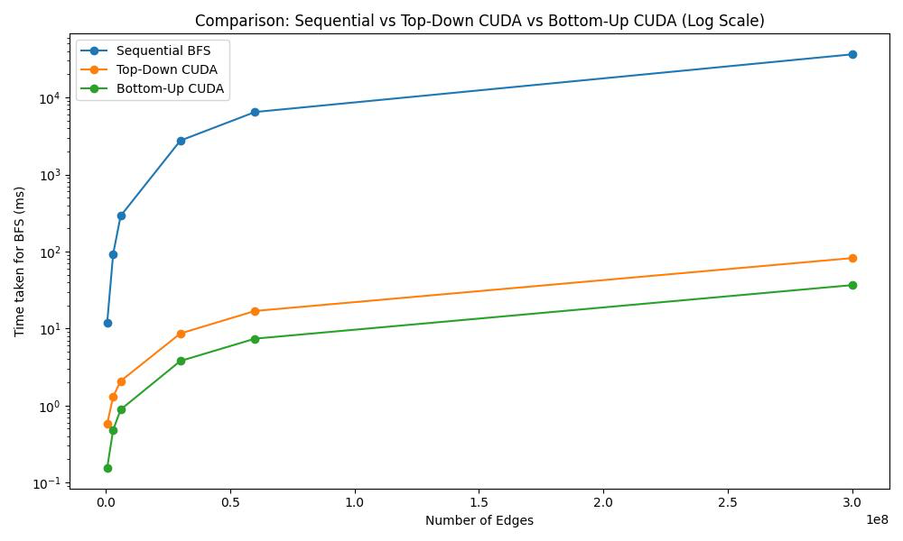
CUDA Top-Down vs Bottom-Up

Slide 19
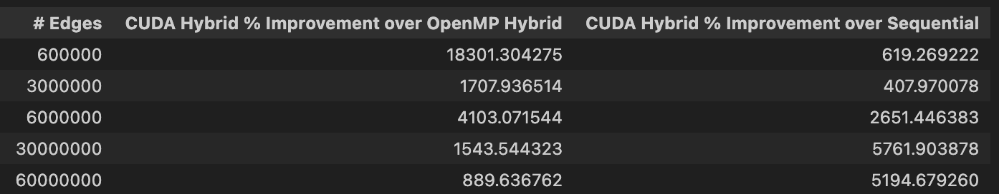
Performance Comparison

Slide 20
Thank you.

